Slide 1
Extract, transform, load
MTN.BI.08
Fact Table Techniques
Elias Nema
Senior Software Engineer
Elias_Nema@epam.com

Slide 2
Data Warehouse Structure
Staging Area
Temporary Loading Structures
Rejected Data
…
Foundation Layer
Process neutral close to 3NF data
Access&Performance Layer
* Datamarts
* Stars
* Cubes
* BI Applications Data

Slide 3
Agenda
Designing Fact Table
Referential Integrity
Types of a Fact Table
Incremental Loading

Slide 4
Designing Fact Table

Slide 5
Fact Table
Dimensional models describe how people measure their world.
To be studied individually, each process should have its own fact table.
The grain of the fact table describes the level of detail at which the facts are recorded.

Slide 6
But what actually is a process?
Is Sales a Process?
For a given pair of facts, ask these questions:
Do these facts occur simultaneously?
Are these facts available at the same level of detail (or grain)?
If the answer to either of these questions is “no,” the facts represent different processes.

Slide 7
Different Timing/Grain
Fact Tables that have different timing sample.
Fact Tables that have different grain sample.

Slide 8
Referential Integrity

Slide 9
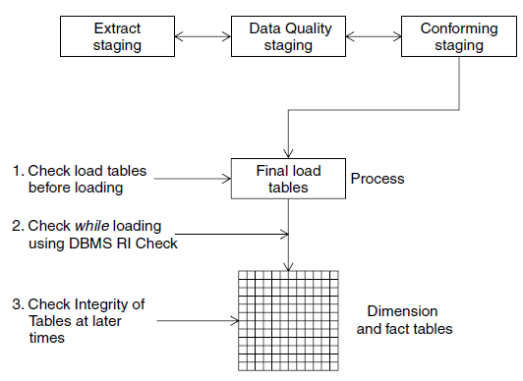
Fact Table: Referential Integrity

Slide 10
Fact Table: Referential Integrity
In dimensional modeling, referential integrity means that every fact table is filled with legitimate foreign keys. Or, to put it another way, no fact table record contains corrupt or unknown foreign key references. There are only two ways to violate referential integrity in a dimensional schema:
Load a fact record with one or more bad foreign keys.
Delete a dimension record whose primary key is being used in the fact table.

Slide 11
Types of a fact Table

Slide 12
Factless Facts
You may be able to define the process, identify fact table grain, and specify numerous dimensions, but find yourself unable to identify any facts.
Analysis is conducted by counting rows in the fact table.
(Web site usage is measured by counting page views or interface clicks; schools and businesses track attendance or absence…)

Slide 13
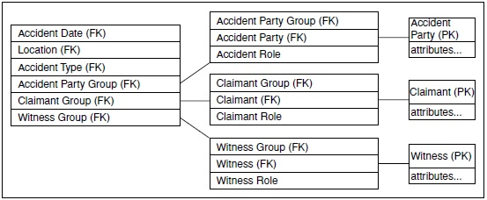
Factless Facts
The grain of every fact table is a measurement event. In some cases, an event can occur for which there are no measured values.

Slide 14

Transaction
Tracks activities that define a business process and supports several facts that describe these activities. It can provide rich analytic possibilities, and often serves as a granular repository of atomic data.
Transaction tables are sparse.
Normally record additive facts.

Slide 15

Snapshot
Periodically samples status measurements such as balances or levels. These measurements may be equivalent to the cumulative effect of a series of transactions but are not easy to study in that format. Some status measurements, such as temperature, cannot be modeled as transactions at all.
Can often be constructed from transaction history. This is an inefficient way to monitor status.
The status measurement is usually semi-additive.

Slide 16
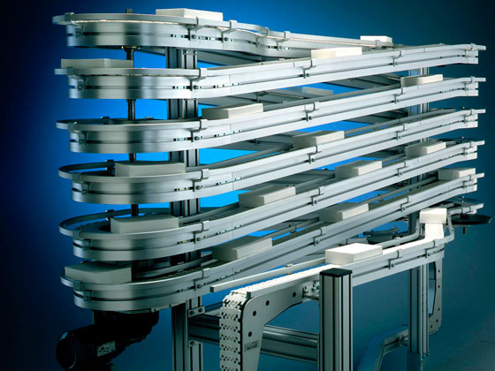
Accumulating Snapshot
Used to track the progress of an individual item through a series of processing steps. It enables the study of elapsed time between major process milestones or events. This kind of fact table correlates several different activities in a single row.
Focus of analysis is the elapsed time between events.

Slide 17
Incremental loading

Slide 18
Load Features: Partitioning
Optimized performance
Comprehensive partitioning strategies to address business problems
One consistent way to manage all your data
Not just for data warehouse and high-end OLTP
New partitioning features bring partitioning to every application
Reduced total cost of ownership
Place less used data on lower cost storage
Proven functionality in 8th generation
Experience comes with age and customer usage

Slide 19
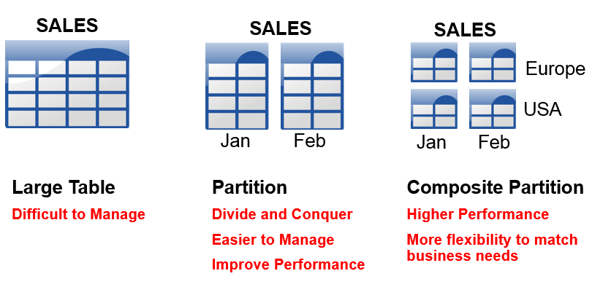
Load Features: Partitioning

Slide 20
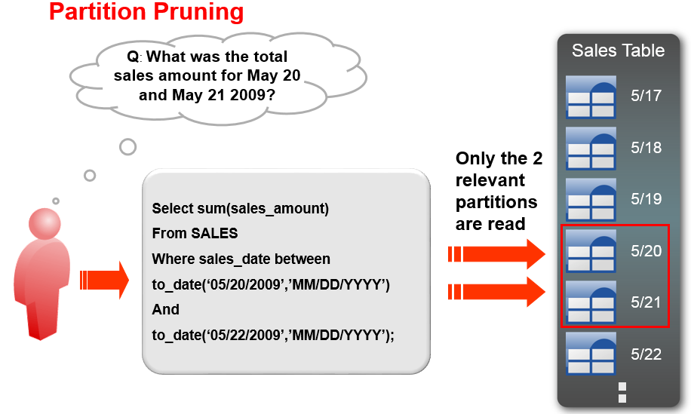
Load Features: Partitioning

Slide 21
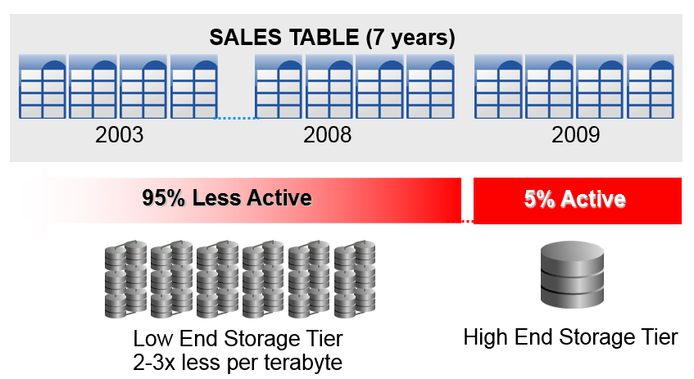
Load Features: Partitioning

Slide 22
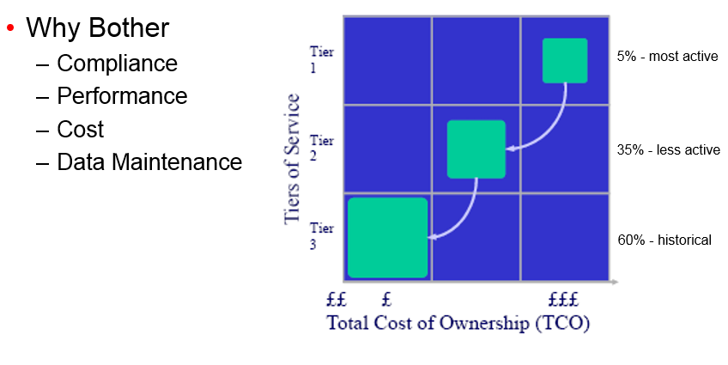
Load Features: Partitioning

Slide 23
Fact Table Techniques
Elias Nema
Senior Software Engineer
Elias_Nema@epam.com

